Slide 1
Intelligent Monitoring of Engineering Systems
Group 3 : Intelligent Monitoring of a Production system
1
Notes:
Speaker notes: Good Morning. I am Rohan Ravi Mani and me and my Group would like to present our findings on the experiment performed on the Intelligent monitoring of a production system.

Slide 2
GROUP 3 : INTELLIGENT MONITORING OF A PRODUCTION SYSTEM
INTRODUCTION
METHODS
RESULTS & DISCUSSION
CONCLUSION & OUTLOOK
2

Slide 3
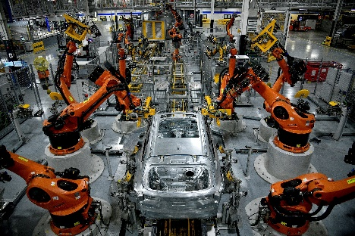
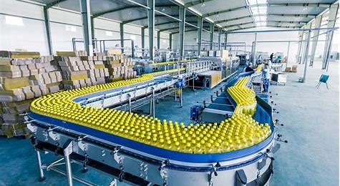
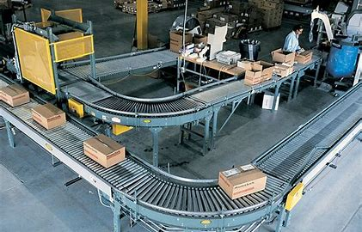
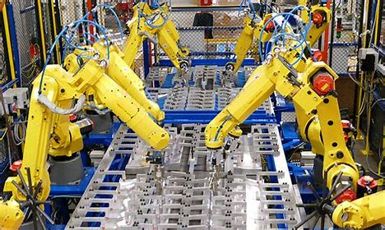
INTRODUCTION
Motivation
The motivation of the Project is to locate defects in a production line in real time so as to prevent any stoppages in the line as a result.
Image 1: Assembly lines
Image Source : Google Images (Links in notes)
3
Notes:
Image Source : https://www.inventiva.co.in/trends/august-industrial-production/ ; http://www.cisco-eagle.com/blog/2013/11/25/the-ultimate-guide-to-conveyor-systems/
https://ta-systems.com/system-categories/assembly-lines/ ; http://foodstuff-africa.com/food-and-beverage-industry-set-to-grow-worldwide/
Speaker notes: Production lines exist in all types of Industries. Any issues in the operations of such a system will affect the entire supply chain, hence causing losses to the organization. Hence our motivation for this project is to locate defects in a production line while the line is operational, so as to prevent any issues that occur before it affects the operations of the system.

Slide 4
INTRODUCTION
Description
The tasks were to obtain acceleration to time data using our mobile phones as it moves across the production line and use the data obtained to figure out the location of the defects by training a ML model to do so.
Division Of Responsibilities
Data Collection
Rohan Ravi Mani, Kshitij Shahare
Data Preprocessing
Rohan Ravi Mani, Vikhyat Jammalamadakka
Feature Selection
Kshitij Shahare, Deven Paul
Deven Paul, Vikhyat Jammalamadaka
Computational Model
Presentation and Report
Rohan Ravi Mani, Kshitij Shahare, Vikhyat Jammalamadakka, Deven Paul
4
Notes:
Speaker notes: Our tasks were to obtain data using our mobile phone’s accelerometer, while it is passing through the production line and trying to locate defects in the system that can affect its operations. Our main goal was to identify frequencies applied to the system and any imbalances in the line in the form of Dampers and Incliners.
We have divided the responsibilities as shown here

Slide 5
METHODS
5

Slide 6
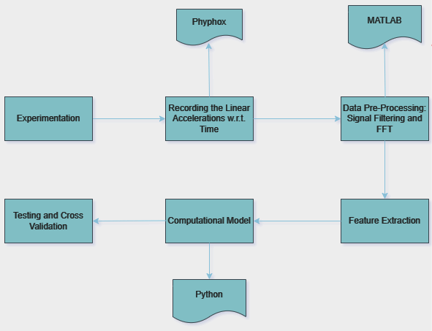
METHODOLOGY
Image 2: Flowchart depicting whole methodology of our project
Image Source : Draw.io
6
Notes:
Speaker notes: We started the experiment by collecting data using our phones with the help of PHYPHOX app. Then we gathered the data of all groups and we pre-processed the data. Parallelly we ran a code on MATLAB for FFT and verified if the frequency matches with the input data set given. Then we decided on the most impactful features which will be used to prepare and train the model in Python. After training the model with training data sets, we test it with testing data sets and validate the output and performance of the model.

Slide 7
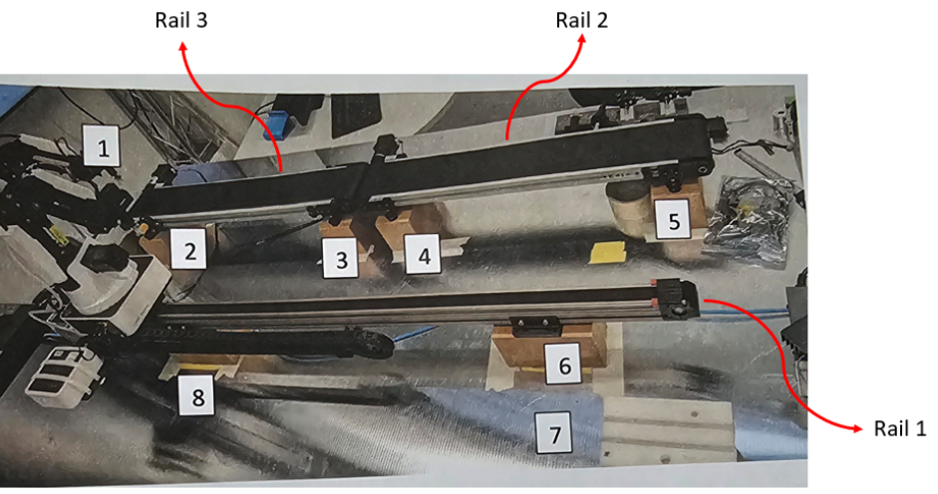
EXPERIMENT
Data Collection
Collect data from the Assembly line by using the sensors of our Cell Phones to record the data while it is moving through the production line.
The Data is collected as Excel files which contains Time, Linear Accelerations with respect to X, Y and Z axes along with an Absolute Acceleration.
Image 3: Assembly line setup
Image Source : Moodle
7
Notes:
So as Rohan mentioned, we started with measuring the time-dependent linear accelerations with the accelerometers in our phone with the Phyphox app on the assembly line. As everyone knows, we had several defects like frequency, damping or inclination as imperfect structures. There was perfect structures as well with no defects.

Slide 8
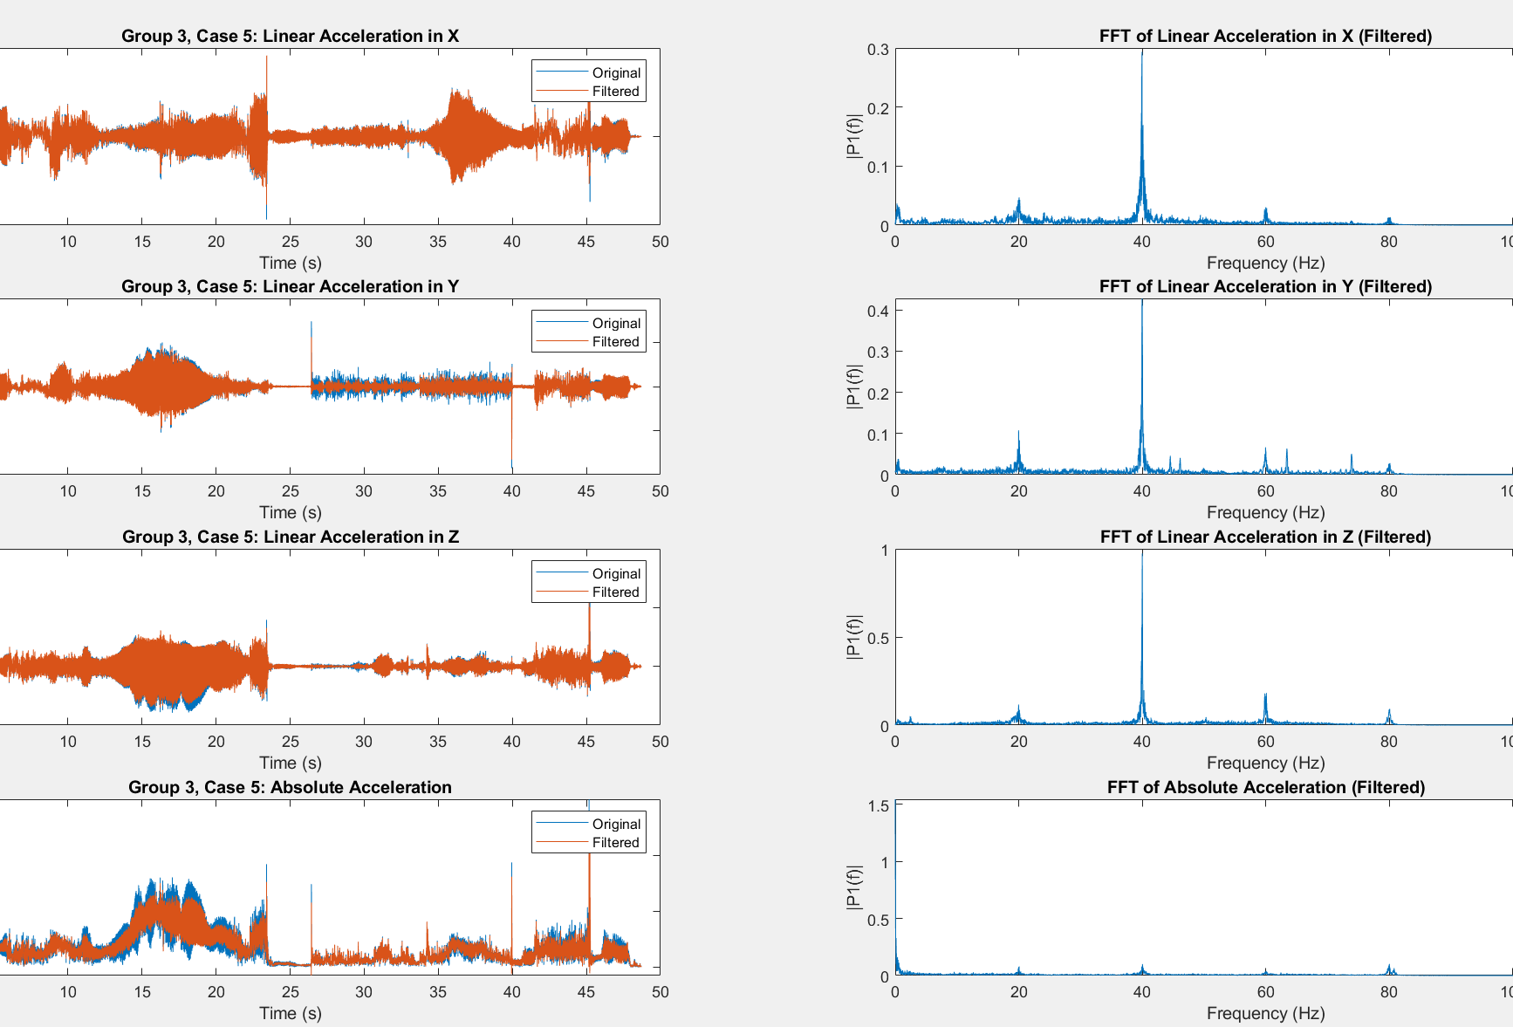
SIGNAL PRE-PROCESSING
Signal Filtering
After data collection, we performed Filtering to remove noise in the data set. Passing the time data through a low pass filter to remove higher frequency according to a cutoff frequency and sampling frequency.
A 4th order Butterworth Filter was used since this filter removes unwanted noise by keeping the signal smooth.
Then conducted an FFT analysis on the data to visualize the frequencies and verify it with the given data.
Image Source : MATLAB
Image 4: FFT performed using MATLAB
8
Notes:
When filtering the signals, we set the cutoff frequency to 80Hz to capture all peak frequencies. By using 4th order Butterworth filter, we filtered the noise and other disturbances. We then performed an FFT on the filtered signal to obtain the frequency peaks. The subplots displayed here shows the occurring peaks at 40Hz.

Slide 9
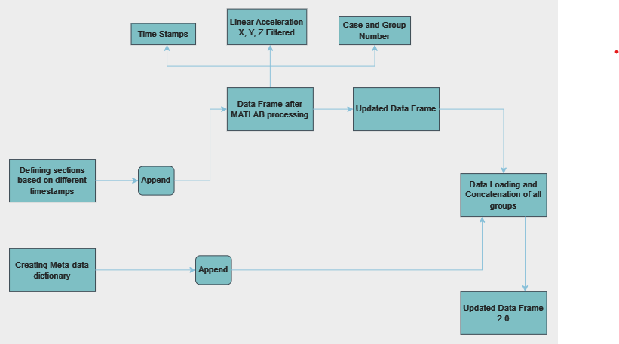
DATASET
Creating A Data Frame
Data Frame creation to train our ML model
Image 5: Flowchart depicting data frame creation
Image Source : Draw.io
9
Notes:
After the signal filtering, we wanted a data frame to train our model. The schematic shows the methodology we opted for creating a data frame. After MATLAB processing, we had time stamps, linear acceleration X Y Z, group and case numbers in our existing data frame. We defined the sections based on different time stamps and appended it to the existing data frame. We also created a metadata dictionary and appended that as well to the updated data frame to create a new dataframe as updated data frame 2.0

Slide 10
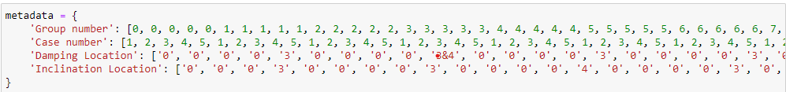
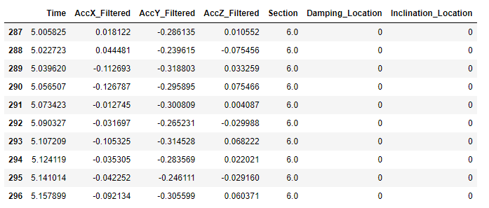
FEATURE SELECTION
Meta-Data
A dictionary created to identify damping and inclination location as per group and case numbers.
Purpose: To be able to classify, for which time stamps or section damping or inclination defect is present in the form of 0s or 1s.
Image 6: Categorization of Data
10
Image Source : Python
Notes:
The metadata is a dictionary which was created to identify damping and inclination location for each case and group numbers. We assigned 0s and 1s to classify, for which time stamp or section the defect occurred. The photo shows the 0s, which means that in section 6 or at time stamp around 5 sec, no damping or inclination present.

Slide 11
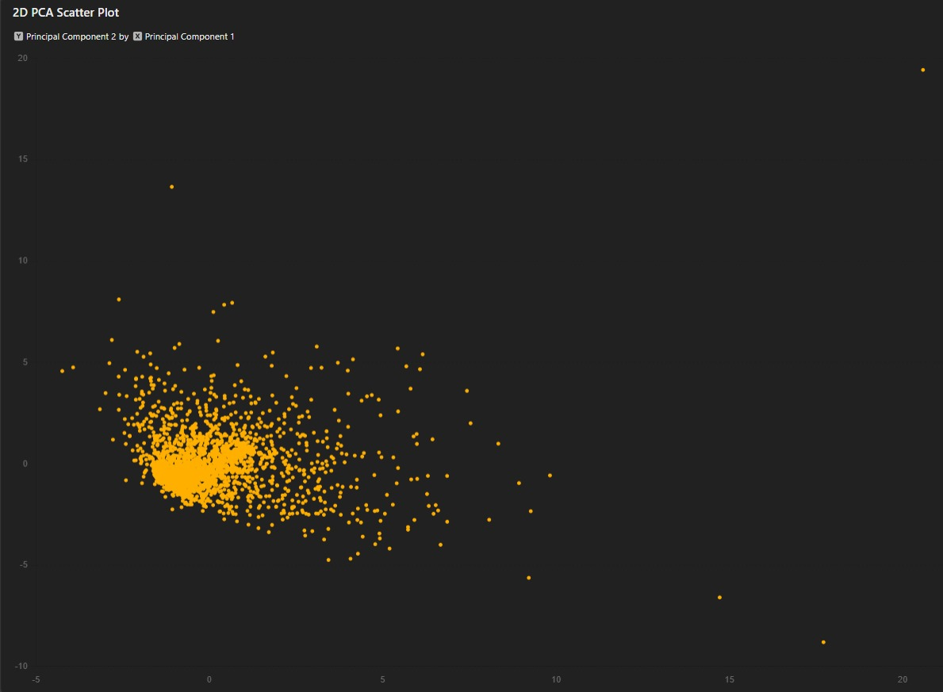
FEATURE SELECTION
PCA Analysis
Used PCA Analysis to do feature selection for Acc (in X,Y,Z), absolute Acc and Acc (in X,Y,Z) post fast Fourier transform.
Acc-X Variance: 0.0329
Acc-Y Variance: 0.0727
Acc-Z Variance: 0.0593
Arrived at conclusion to use Accelerations in X, Y and Z direction to train the model.
Image 7 : 2D PCA Scatter Plot
Image Source : Python
11
Notes:
After we got updated data frame 2.0, we ran an PCA analysis to understand which feature was the most impacful. The results are shown on the slide with the most variance, which were AccX, AccY, AccZ. To get more accurate model, we decide to select all 3 accelerations for the model. Further, the model details, will be explained by my colleague, Vikhyat.

Slide 12
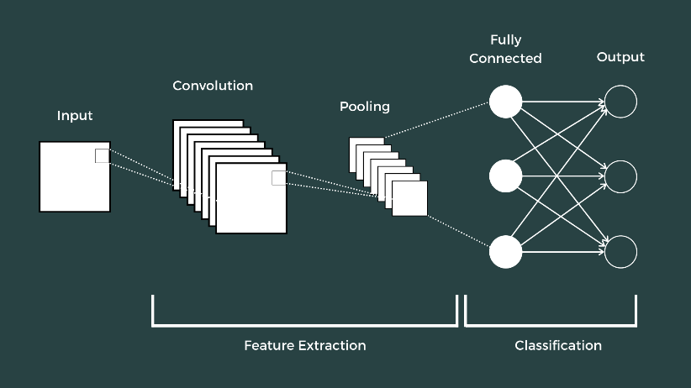
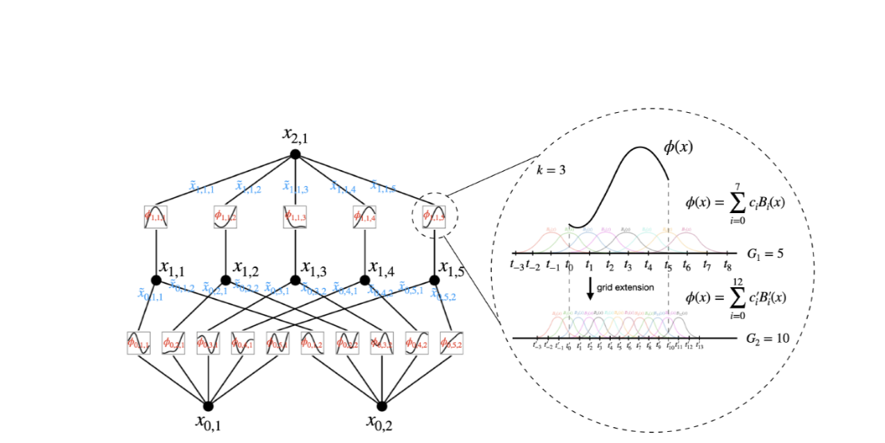
COMPUTATIONAL MODEL
Selection of Computational Model
Principally, we made use of Fast Fourier Transform algorithm for Signal testing.
Since we had time-series data we short-listed LSTM , CNN and Fully connected feed-forward.
But finally went ahead with :
CNN
KAN
Our primary CNN model had the highest recorded accuracy
Image 8 : Convolutional Neural Network
Image 9 : Kolmogorov-Arnold Network
Image Source : KAN: Kolmogorov–Arnold Networks – Ziming Liu, Max Tegmark – 2404.1975
12
Notes:
https://www.theclickreader.com/introduction-to-convolutional-neural-networks/
On this slide, we focus on the selection of our computational model. We started by using the Fast Fourier Transform (FFT) algorithm for signal testing, which was necessary given our time-series data. After considering various models good for handling time series data, including LSTM, CNN, and fully connected feed-forward networks, we chose the Convolutional Neural Network (CNN) and the Kolmogorov-Arnold Network (KAN). Our primary CNN model demonstrated the highest accuracy. You can refer to the images on the slide for a visual representation of these models and the sources listed for more detailed information​

Slide 13
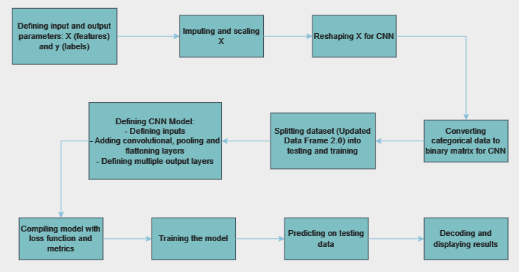
MODEL INFORMATION
Convolutional Neural Network
Working of our CNN Model
Image 10: Flowchart of our CNN Model
Image Source : Draw.io
13
Notes:
This slide provides an in-depth look at the workings of our CNN model. Our first few iterations of the model, we tried predicting Inclination, Damping and Frequency location, but then for further iterations we decided to make amore sophisticated model for just damping and inclination location. We used time stamps, accelerations, damping, inclination locations, and section-wise categorization as input for our training data. For testing, we included similar inputs but identified frequency values through FFT in Python. The flowchart on the slide outlines our CNN model’s structure and data flow​, highlighting the flow from input to output.

Slide 14
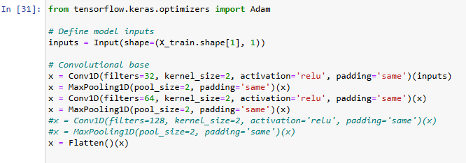
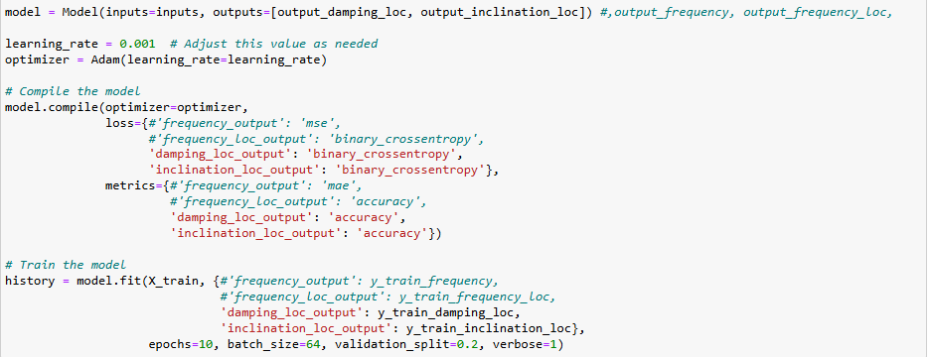
MODEL INFORMATION
Convolutional Neural Network
Input signal Assignment:
Time, Acc (in X,Y,Z) and Section
the number and signal assignment of input
Training : (207965 , 5 , 1)
Model Structure:
Fully connected Conv1D, two hidden layers and ReLU activation.
Hyper-parameter and Model tuning over learning rate, loss function and input/output.
Image 11 : Model Creation
Output signal Assignment:
Model output generates categorical values for Damping and Inclination Location
the number and signal assignment of output
Training : (207965 , 2)
Image 12 : 1D CNN Model Compilation
Image Source : Python
14
Notes:
Fully Connected Conv1D: This refers to a one-dimensional convolutional layer fully connected to the subsequent layers, allowing the model to capture temporal dependencies in the data.
Two Hidden Layers: These layers help the model learn complex patterns by transforming the input data into a higher-level representation.
ReLU Activation: The Rectified Linear Unit (ReLU) is used as the activation function, introducing non-linearity to the model and helping it learn intricate patterns more effectively.
We adjusted various hyper-parameters such as learning rate and loss function to optimize the model’s performance.

Slide 15
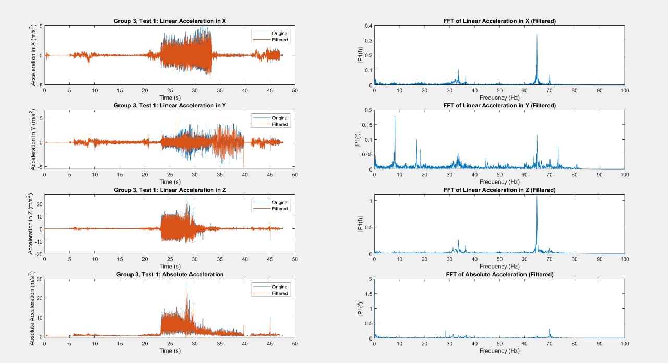
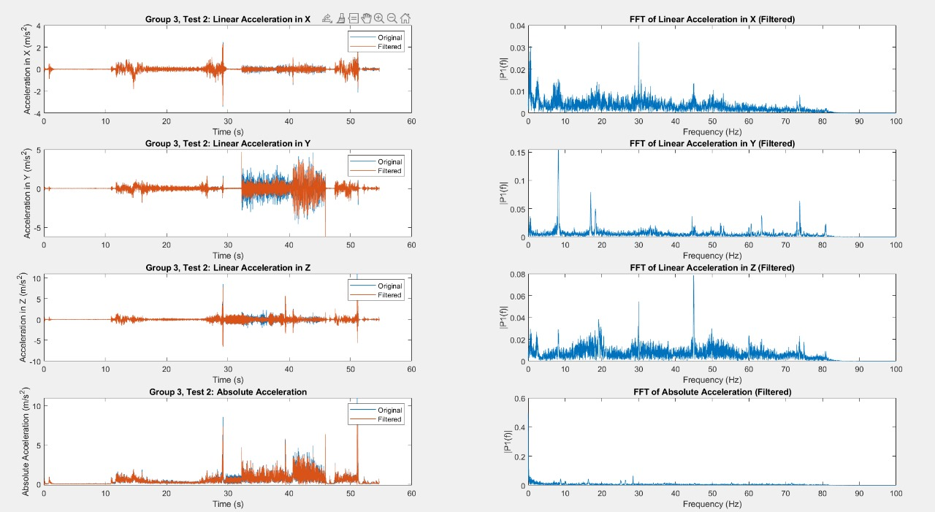
RESULTS & DISCUSSION
Frequency Result from MATLAB FFT
For the testing data received, after running an FFT on MATLAB, we got the frequency peaks for cases 1, 3 and 5 with 65 Hz.
For cases 2 and 4, we got no peaks.
Image 13: MATLAB FFTs on Testing Data
Image Source : MATLAB
15
Notes:
As mentioned before, owing to our first few iterations, we chose to run the CNN model to find out only the Damping and Inclination Location. For Frequency, we visually observed the peaks on the FFT plots to identify the frequency associated with the test case. For test cases 1, 3 and 5 that we were given, we identified a frequency of 65Hz whereas in cases 2 and 4, we identified no such peaks.

Slide 16
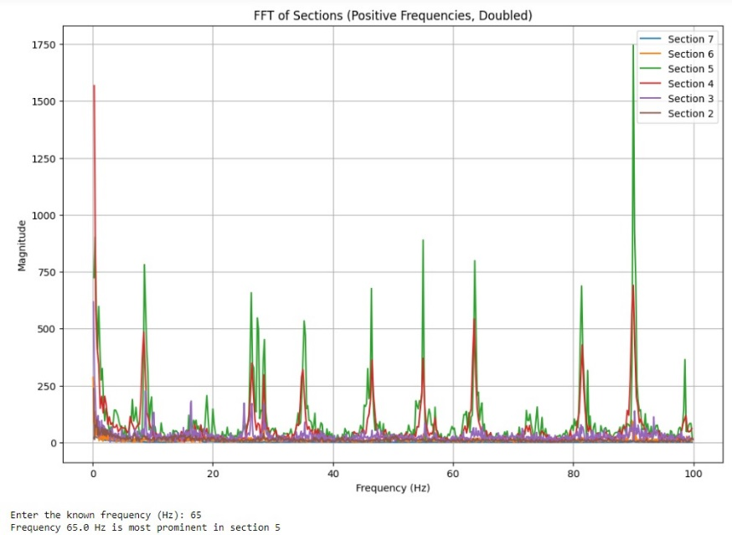
RESULTS & DISCUSSION
Frequency Location Prediction using Python
For the testing data received, after running an FFT on Python, we got the frequency locations at location 5 for test cases 1, 3 and 5.
Image 14 : FFT on Group –Test Data
Image Source : Python
16
Notes:
Here, we present the frequency location predictions made using Python. The testing data, after FFT analysis, indicated frequency locations at position 5 for test cases 1, 3, and 5. The visual representation on the slide aids in understanding how our model predicts frequency locations accurately based on the input data

Slide 17
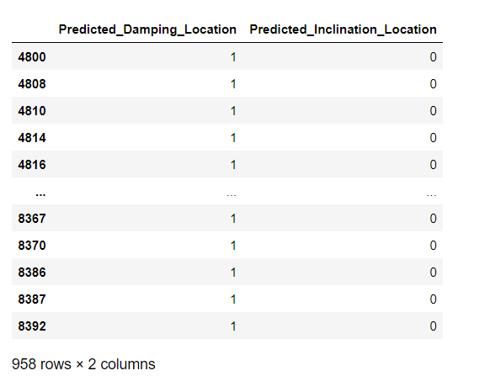
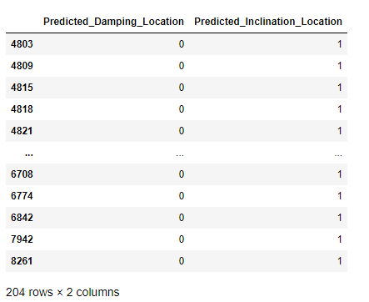
RESULTS & DISCUSSION
Prediction of Damping and Inclination
Generated CSV files with Damping and Inclination predictions.
The number of 1s predicted for Damping and Inclination Location corresponds to the predicted location. Shown below an example from Test Case 5
Image 15 : Predicted Damping Location
Image 16 : Predicted Inclination Location
Image Source : Python
17
Notes:
Finally, we discuss the CSV files generated with damping and inclination predictions. The number of 1s predicted corresponds to the actual damping and inclination locations with respect to the serial numbers which correlate to the time stamps which in turn are associated with a specific location. An example from test case 5 is shown, demonstrating our model’s prediction accuracy. This slide highlights the practical application and validation of our model predictions using real data

Slide 18
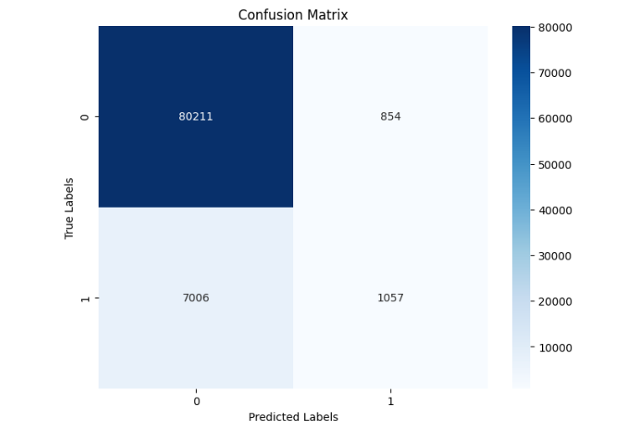
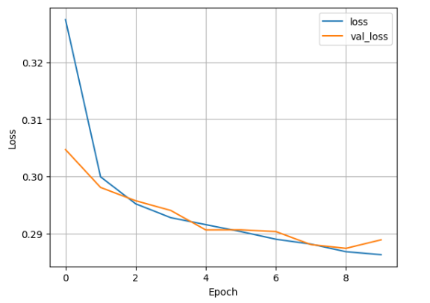
RESULTS & DISCUSSION
Cross Validation
Validation Input Assignment:
the number and signal assignment of input
Training : (89128 , 5 , 1)
Validation Output Assignment:
the number and signal assignment of input
Training : (89128 , 2)
Validation Metrics:
Damping Loc :
Accuracy : 91.19%
F1 Score : 0.89
Inclination Loc :
Accuracy : 94.95%
F1 Score : 0.93
Image 18 : Confusion Matrix Damping Location
Note : While the recall for ‘1’ were 0.15, the model predicted with 0.60 precision.
Image 17 : Loss vs Epoch
18
Image Source : Python

Slide 19
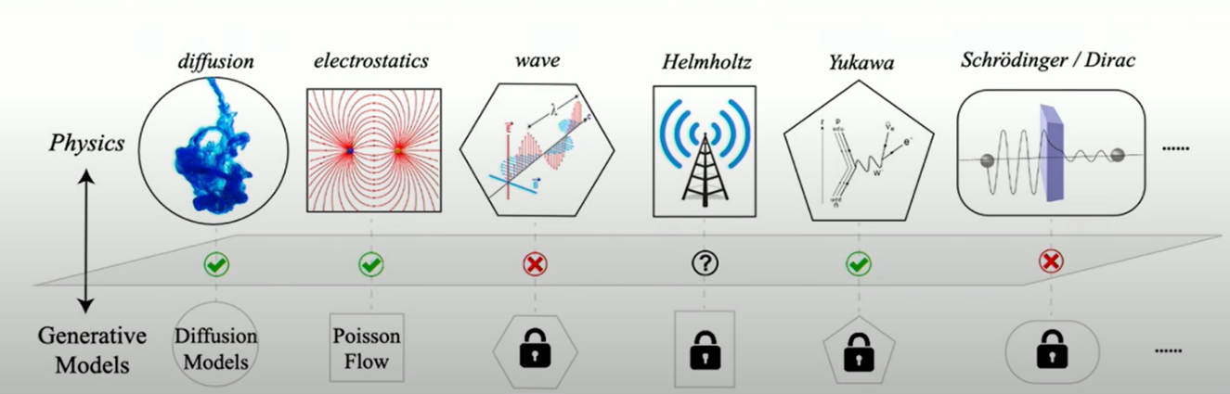
RESULTS & DISCUSSION
Test Case | Frequency | Frequency Location | Inclination Location | Damper Location
1 | 65 Hz | 5 | - | -
2 | 0 | - | 4 | 3
3 | 65Hz | 5 | - | -
4 | 0 | - | - | 3
5 | 65Hz | 5 | - | -
Generalization Ability
Conv1D CNN :
Generalization ability :
Did it work? Yes, but.
A Universal convertor that followed concrete protocol to convert physics to generative model.
Generative model did not have desirable properties
Table 1 : 1D CNN Model Predictions
Image 19 : Physics to Generative Models
Image Source : YouTube - Generative AI in STEM Symposium 2024 – Ziming Liu
19

Slide 20
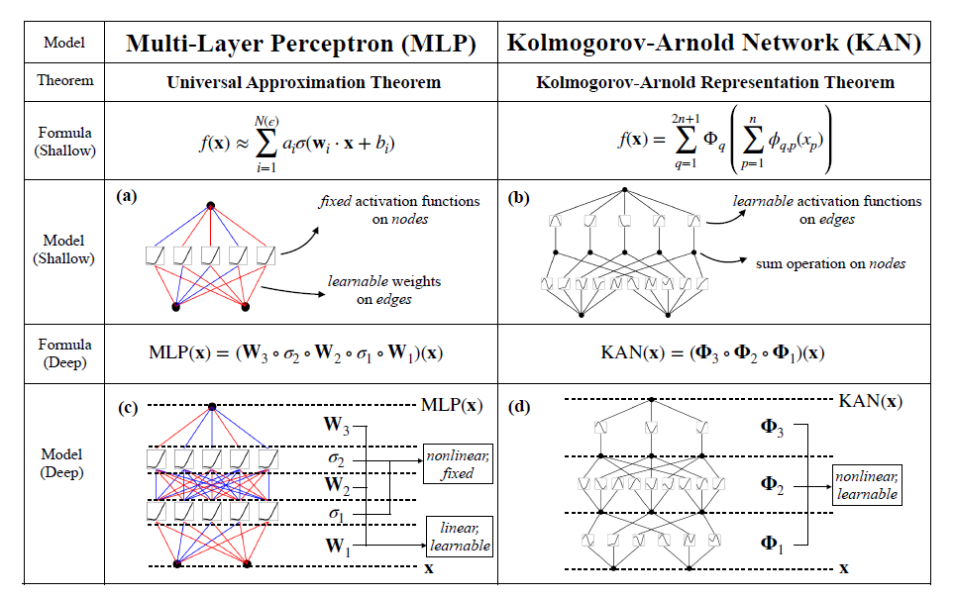
MODEL INFORMATION
KAN : Kolmogorov-Arnold Network
No working model:
KAT and Neural Networks:
The connection between the Kolmogorov-Arnold theorem (KAT) and neural networks is not new in the literature
Most of these prior works stick to the original 2-layer width-(2n+1) networks, which were limited in expressive power and many of them are even predating back-propagation
KANs are also somewhat related to generalized additive models (GAMs) , graph neural networks and kernel machines.
The connections are intriguing and fundamental but might be out of the scope
Image 20 : Multi-Layer Perceptron vs Kolmogorov Arnold Network
Source :KAN: Kolmogorov–Arnold Networks – Ziming Liu, Max Tegmark – 2404.1975
20
Notes:
Inspired by the Kolmogorov-Arnold representation theorem, we propose Kolmogorov-
Arnold Networks (KANs) as promising alternatives to Multi-Layer Perceptrons (MLPs).
While MLPs have fixed activation functions on nodes (“neurons”), KANs have learnable
activation functions on edges (“weights”). KANs have no linear weights at all – every
weight parameter is replaced by a univariate function parametrized as a spline. We believe
that this seemingly simple change makes KANs outperform MLPs in terms of accuracy
and interpretability, on small-scale AI + Science tasks. For accuracy, smaller KANs can
achieve comparable or better accuracy than larger MLPs in function fitting tasks. Theoretically
and empirically, KANs possess faster neural scaling laws than MLPs. For interpretability,
KANs can be intuitively visualized and can easily interact with human users.

Slide 21
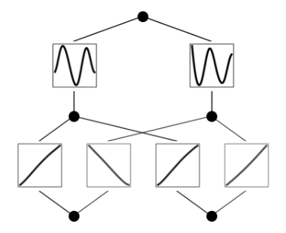
RESULTS & DISCUSSION
Example KAN : Classification
Let’s then treat the problem as a regression problem (output dimension = 2, Cross Entropy loss).
Create the two-moon dataset
did it work? ➔ Yes
Training Accuracy : 97.0%
Testing Accuracy : 96.60%
Did it work for our experiment?
Multiple iterations were made, but due to recent publication and updating GitHub Repository, few parameters remains to be tested.
KANs received their latest major update on 13th July.
Image 21 : Trained KAN model for 2D Poisson equation with boundary conditions and ground truth solution
Image Source :KAN: Kolmogorov–Arnold Networks – Ziming Liu, GitHub Repository
21
Notes:
Examples in tutorials are runnable on a single CPU typically less than 10 minutes. All examples in the paper are runnable on a single CPU in less than one day. Training KANs for PDE is the most expensive and may take hours to days on a single CPU. We use CPUs to train our models because we carried out parameter sweeps (both for MLPs and KANs) to obtain Pareto Frontiers. There are thousands of small models which is why we use CPUs rather than GPUs. Admittedly, our problem scales are smaller than typical machine learning tasks but are typical for science-related tasks. Since the task at hand is large, it was advisable to use GPUs.

Slide 22
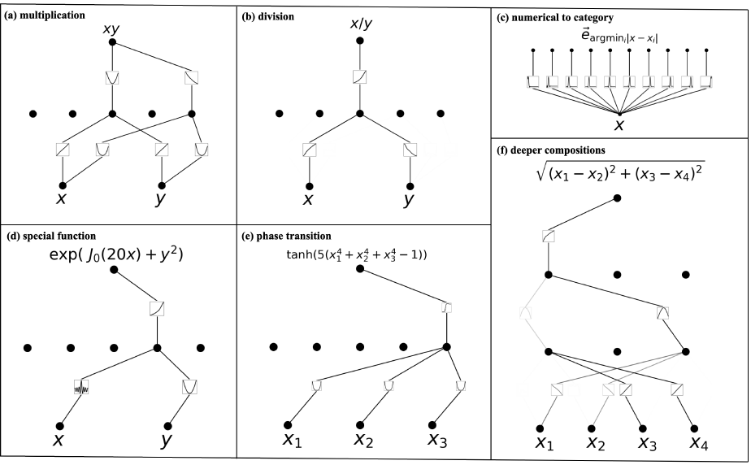
CONCLUSION & OUTLOOK
CONCLUSION
CNN was used to find defects because of its performance for classification in time-series data.
We obtained an accuracy of 91% for Inclination location and 94.9% for the damper location
There were issues in generalizing the model because catastrophic forgetting is a serious problem in current machine learning.
OUTLOOK
Application of KANs in Engineering systems.
Possible collaboration with author :
KANs maybe the next best non-linear regressor
PDE implementation in CNNs for frequency detection
Image 22 : KANs are interpretable for simple symbolic tasks
Source :Ronald Kemker, Marc McClure,.Measuring catastrophic forgetting in neural networks. In Proceedings of the AAAI conference on artificial intelligence, 2018
Image Source : KAN: Kolmogorov–Arnold Networks – Ziming Liu, GitHub Repository
22
Notes:
Catastrophic forgetting is a serious problem in current machine learning [40]. When a human masters
a task and switches to another task, they do not forget how to perform the first task. Unfortunately,
this is not the case for neural networks. When a neural network is trained on task 1 and then
shifted to being trained on task 2, the network will soon forget about how to perform task 1.

Slide 23
23

